Slide 1
Text Mining
Maksimilijan Japundžić

Slide 2
Uvod
Tema – usporedba prvog i drugog dijela knige The Godfather, Mario Puzo

Slide 3
Opseg teksta

Slide 4
Najčešće riječi
Prvi dio | Drugi dio
wa (913) | wa (488)
said (486) | said (189)
hagen (325) | johnny (184)
would (920) | vito (144)
michael (286) | would (124)
corleone (280) | corleone (122)
sonny (280) | could (108)
man (249) | one (95)
sollozzo (210) | nino (92)
family (192) | man (88)
imena glavnih likova
najčešće radnje, glagoli

Slide 5
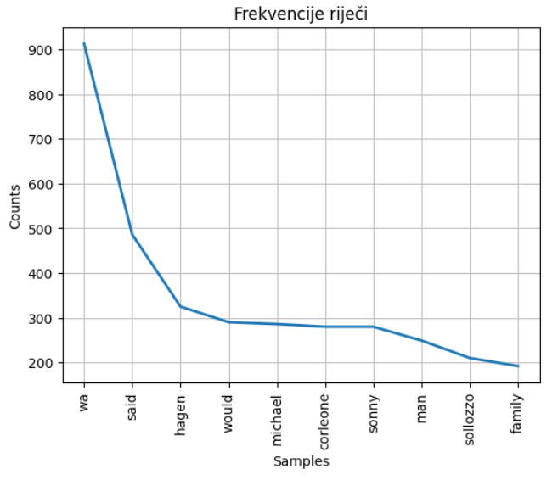
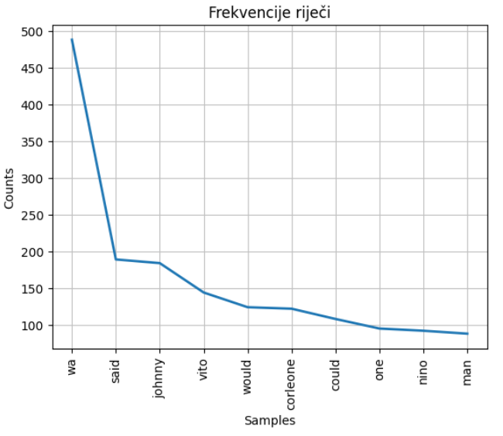
Graf frekvencije

Slide 6
Kolokacije
Prvi dio | Drugi dio
old man | Vito Corleone
Johnny Fontane | New York
New York | Johnny Fontane
Paulie Gatto | hundred dollars
Luca Brasi | Deanna Dunn
Long Beach | Johnny said
Hagen said | seven hundred
Tom Hagen | Jack Woltz
Amerigo Bonasera | Genco Abbandando
police captain | air shaft

Slide 7
Leksični diverzitet
Prvi dio – 0.165
Drugi dio – 0.263

